Slide 1

Sleep Tracking for Cancer Patients
Lael Rudd
CS 6440 Fall 2025
lrudd6@gatech.com

Slide 2

Project Summary
Lightweight tool that simulates and visualizes sleep patterns for cancer patients
Converts sleep data into FHIR Patient, Condition and Observation resources
Simple, interactive dashboard for viewing multiple nights of sleep
Deployed on Rendor

Slide 3
Background and Need
Sleep problems are common during cancer treatment
Sleep data is often buried in unstructured clinical notes
Sleep trackers exist (such as wearable devices) but use proprietary and non-FHIR formats
Clinicians need structured data such as FHIR formats

Slide 4
Solution Overview
Python backend using Flask
Synthetic sleep generator (single and multi-night)
Dashboard with HTML, JavaScript, and Chart.js visualization
FHIR JSON using Resources:
  Patient
  Condition (Cancer)
  Observation (Sleep duration and data)
Deployed on Render

Slide 5
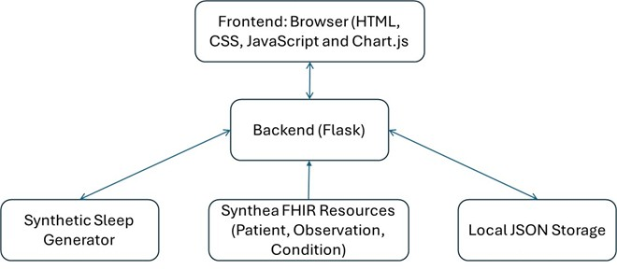
Architecture Diagram

Slide 6
Workflow
Generate synthetic sleep data
Wrap data in FHIR resources
Provide API endpoints
Dashboard fetches multi-night series
Chat.js visualizes total sleep hours
FHIR JSON is viewable directly

Slide 7
Key Features
Multi-night sleep series
Probability-based sleep quality
Patient information panel
FHIR bundle output
Deployed on Rendor
Simple, readable dashboard

Slide 8
Demo
Dashboard overview
Multiple-night sleep graph
Raw sleep JSON
FHIR bundle view
Rendor deployment

Slide 9
Future Work
Store data instead of regenerating (remove stateless issues on each API)
Connect to a real FHIR server
Multiple patient
Wearable device data

Slide 10
Conclusion
Demonstrated sleep tracking for cancer patients aligned with FHIR
Provided structured and interoperable sleep data
Lightweight, understandable, and fully deployed

